Slide 1
Mone-G Onboarding Phase 01: Pilot

Slide 2
Purpose and Contents
The Onboarding document is aimed at all the team members joining the Mone-G project. The purpose of this document is to introduce the whole Mone-G program to the team members and give a brief picture on the background, timelines and where we are with respect to the overall schedule.
Contents:
Section 1. Introduction to Mone-G
Section 2. Project Timeline
Section 3. Organization Structure
Section 4. Relevant Access
Section 5. Work Culture
Section 6. Useful Links
Section 7. Compliance

Slide 3
Introduction

Slide 4



What’s Mone-G?
The project name “Mone-G” stands for “Mitsubishi chemical group ONE ERP platform for Global group companies”.
Mone-G brings one common template; standardized end-to-end process, ERP system, and data.
As-Is
To-Be
28 different SAP and other ERP are up and running in 120 entities
One standard template deployed to global group companies
China
1
SAP client and other ERP
EMEA
16
different SAP clients and other ERP
Standardized end-to-end processes
America
9
different SAP clients and other ERP
Consolidation of ERP systems
APAC
2
different SAP clients and other ERP
Data governance and quality standards
e.g., MCA has 10 entity

Slide 5

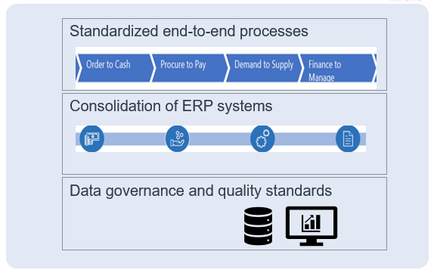



What’s Mone-M/G/J?
Legend
The project name “Mone” stands for “Mitsubishi chemical group ONE ERP platform”.
Mone brings one common template to MCG group which will be sequentially deployed as shown below.
Standardization
Integration
MCC integration (Former MCC+MRC+MPI)
Now
Mone-G adaption to Japan
M
Mone-M
Mone-M
Mone-J
One standard template deployed to all MCG group companies
Global group companies outside of Japan
G
Mone-G
Japanese group companies
J
Mone-J

Slide 6
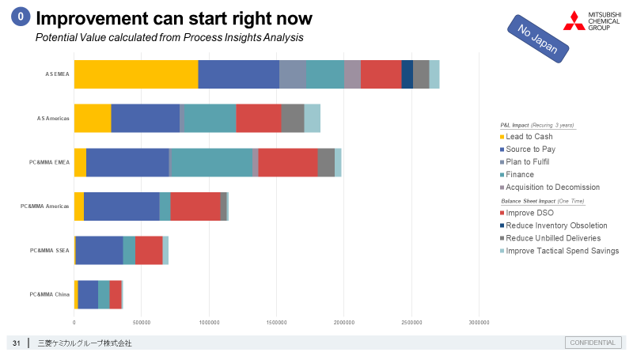
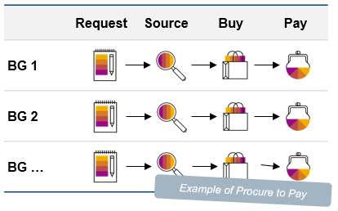
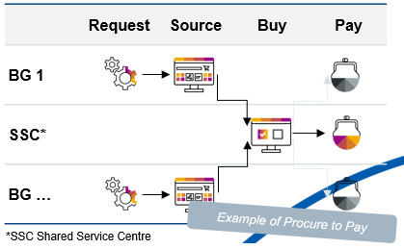
MCG transformation journey and potential value
There are 3 steps in our transformation journey; Tactical improvement, Basic Transformation, and Process Transformation.
Basic Transformation is the goal of Mone-G where end-to-end process, ERP system, and data are globally standardized.
We will achieve quick wins collaborating with each BU/FU in Tactical Improvement.
Potential value was identified through the benchmark studies. Committing amount and actions to be determined in Phase 1.
Mone-G
Tactical Improvement
Basic Transformation
Process Transformation
Quick Win
Standardize
Simplify
Potential value (oku-yen)
Potential value (oku-yen)
Potential value (oku-yen)
PL 120 (5years) BS/CF 15
PL 81 (5years) BS/CF 82
PL 518 (5years) BS/CF 222

Slide 7
Goal of Mone-G : Basic Transformation
Organizations, processes, data, systems, rules, and people are key success factors to achieve potential value.
Data-driven management
Strengthening governance
Optimized, simple, and modernized business process
Cost reduction, CF improvement
Key success factors for Basic Transformation
Potential value
Organization
Establish a permanent organization to maintain and improve standard business processes and systems
Processes
Define and deploy standard business processes based on SAP best practices
Data
Build data governance, unify data granularity (use same data across MCG), link to management reports
Systems
Development and deployment of SAP S/4 HANA standard template
Globally standardized end-to-end process, ERP system, and data
Rules
Establish rules for internal cost sharing in management accounting for infrastructure development costs.
People
Shift to new way of working with understanding of the transformation and new mindset through workshops

Slide 8
Scope of Mone-G
Order to Cash, Procure to Pay, Demand to Supply, and Finance to Manage are the scope of Mone-G
R & D
Commercial
Procurement
Operation
Finance
HR
Support Process
Design to Product Introduction
Prospect to Order
Order to Cash
Procure to Pay
Demand to Supply
Plan to Move
Finance to Manage
Invest to Divest
Recruit to Retire
QC/QA
Product
Stewardship
LV1
Develop New Product
Capture New Business
Sales
Supply Chain Management
Finance & Accounting
Human
Resources
Quality
Management
EHS
Identify & Develop Market
Forecast Sales
Receive Order /
Receive Request
Receive Request
Forecast Demand / Supply
Manage Orders
Define Financial Structure & Plans
Request Resources
Organizational Management
Define Financial Structure & Plans
Raw Materials
Manage Campaigns
Generate Leads
Process Order /
Process Service
Locate Source / Create Contracts
Request / Reserve Resources
Plan & Tender Freight
Pl Record / Settle Transactions
Invest
Personnel Administration
Pl Record / Settle Transactions
Product Development
Manage Contacts /Retain Customers
Negotiate and Accept Order
Distribute Goods/
Service Execution
Order Materials
Plan / Schedule Production
Execute & Monitor Freight
Close / Consolidate
Manage Projects / Internal Orders
Negative Time Management
Close / Consolidate
Production & Operation
Plan New Products
Manage Customer Relationships
Invoice Customer
Receive & Manage Materials
Produce Quality Product
Calculate Charges & Settle
Report Results
Period / Year End Close
Positive Time Management
Report Results
Logistics & Distribution
Develop New Product & Process Design
Service and Support Customer
Manage Accounts Receivable
Manage Accounts Payable
Manage Inventory & Assets
Source & Procure & compliance
Support Decisions & Compliance
Project / Program Close
Travel Management
Support Decisions & Compliance
Product Use & End of Product Life
Test New Product & Processes
Mone-G scope
Mone-G scope
launch Product
Post-Launch Enhancement & Support
Requires additional SAP modules

Slide 9

Scope of Mone-G – SAP Modules
Order to Cash
Procure to Pay
Demand to Supply
Finance to Manage
Sales
Supply Chain Management
Finance & Accounting
Process
SAP Module
Process
SAP Module
Process
SAP Module
Process
SAP Module
Receive Order /
Receive Request
SD
Receive Request
MM
Forecast Demand / Supply
PP
PPDS
IBP
Define Financial Structure & Plans
FICO
Process Order /
Process Service
SD
Locate Source / Create Contracts
MM
Request / Reserve Resources
PP
Pl Record / Settle Transactions
FICO
Distribute Goods/
Service Execution
SD
TM
EWM / WM
EHSM
Order Materials
MM
EHSM
Plan / Schedule Production
PP
Close / Consolidate
FICO
PS
Invoice Customer
SD
GTS
Receive & Manage Materials
MM
EWM / WM
Produce Quality Product
PP
QM
Report Results
FICO
Manage Accounts Receivable
FI
Manage Accounts Payable
MM/FI
VIM
Manage Inventory & Assets
PP
PM
EWM / WM
Support Decisions & Compliance
FICO
Requires additional scope
Currently included in Mone-G
Currently not included in Mone-G
Currently not included in Mone-G and requires extra-license
9
Mitsubishi Chemical Group

Slide 10
Project Timeline

Slide 11
Schedule
Phase 1 is from April 2023 to April 2024, goals of which are template development, pilot deployment, and entire project planning to get approval of phase 2.
Phase 2 is deployment outside of Japan for 3 years covering over 120 entities. Planning of Japan adaption will also be started.
Approval of Phase 1
Approval of the entire project
FY2022
FY2023
FY2024
FY2025
FY2026
FY2027
Phase 0
BPC assignment
Template assessment
Planning
Phase 1
Template development
Pilot deployment
Entire planning
Phase 2
Deployment outside Japan
Planning of Japan adaption
Post Mone-G
Deployment to Japan
4 entities standardized
35 entities standardized
55 entities standardized
26 entities standardized

Slide 12
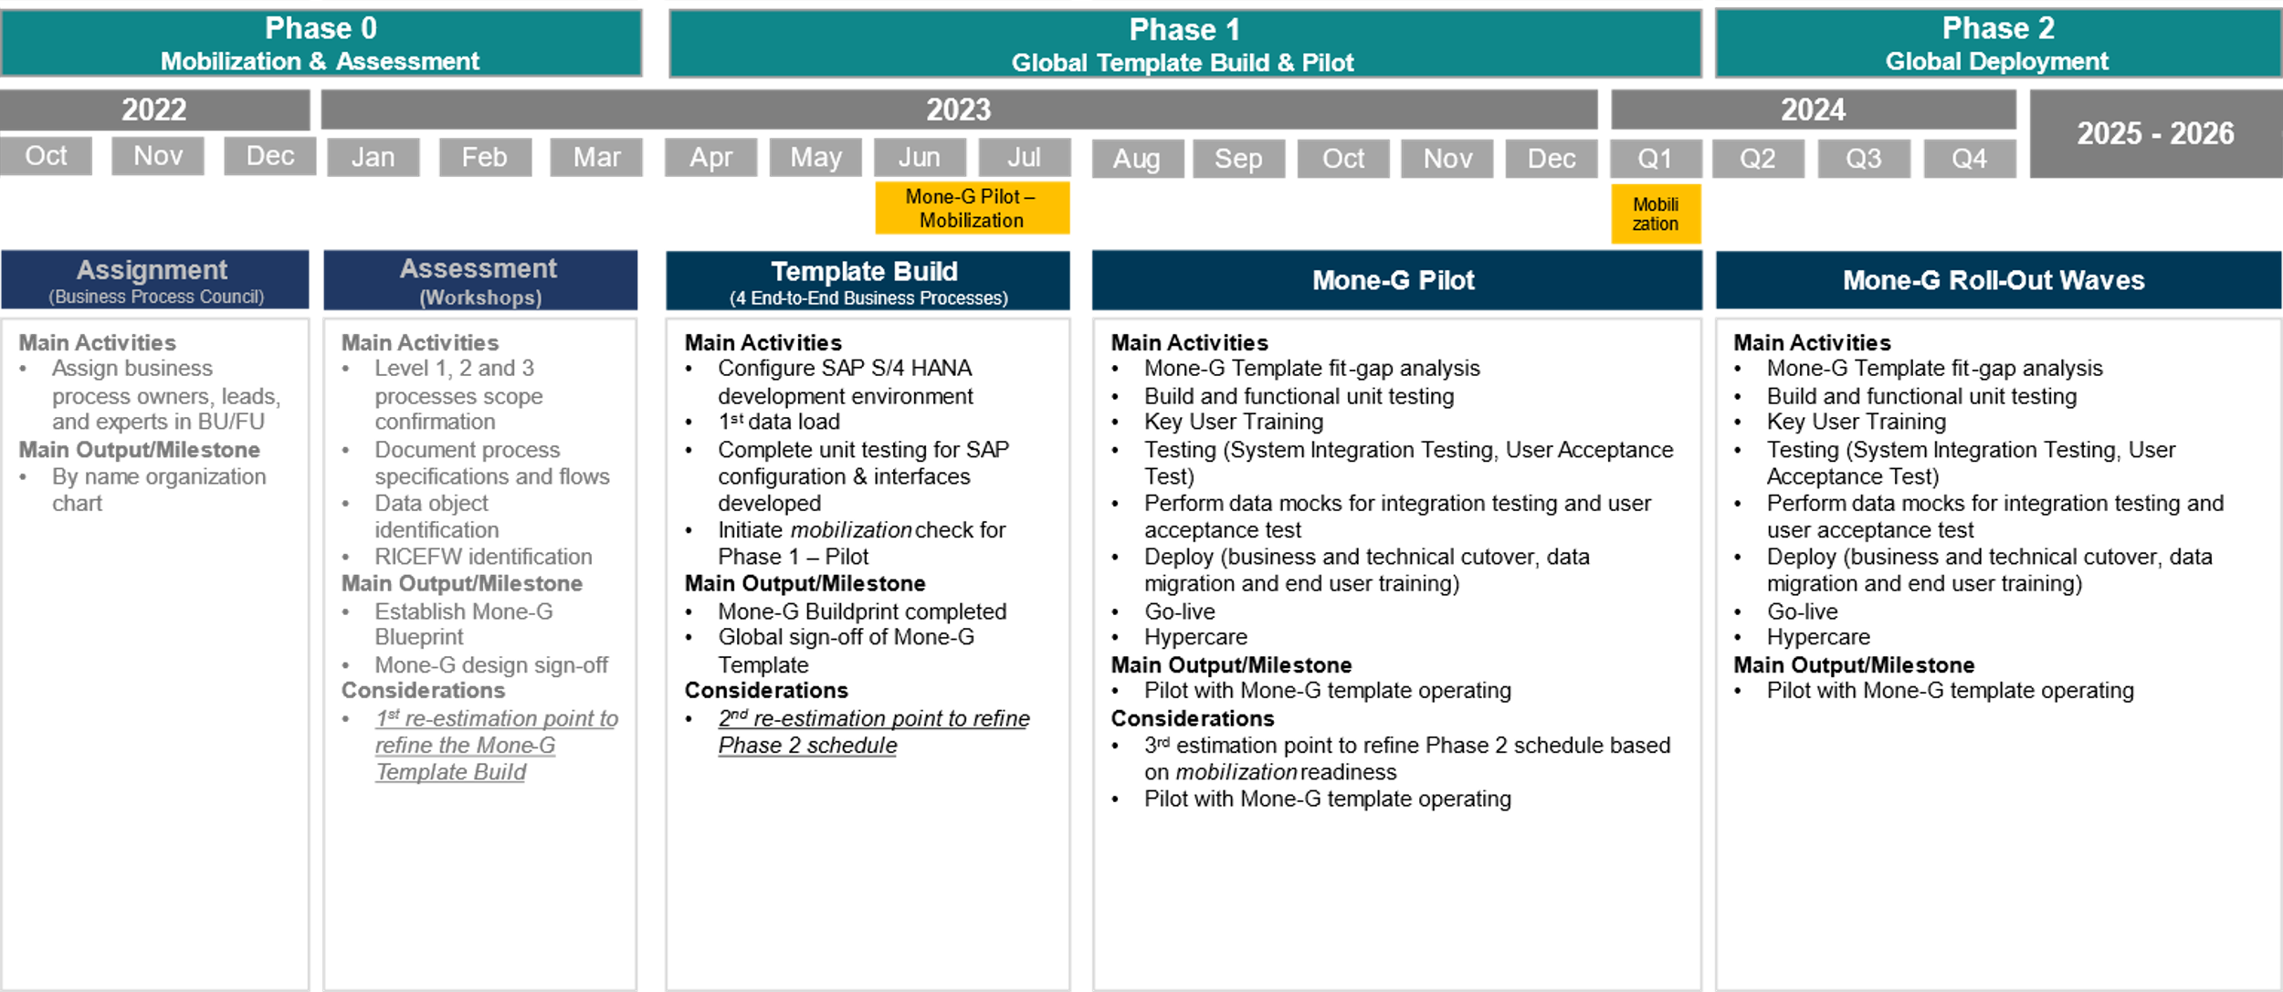
Overall Project Plan
NOW

Slide 13
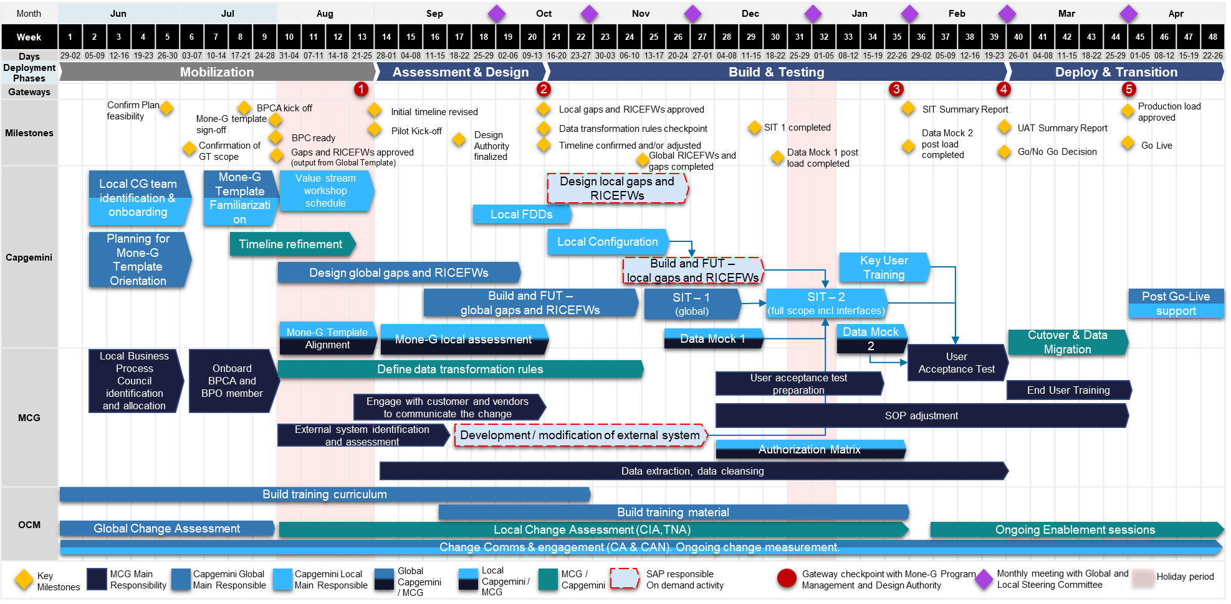
High level plan – Pilot phase

Slide 14
Organization Structure

Slide 15
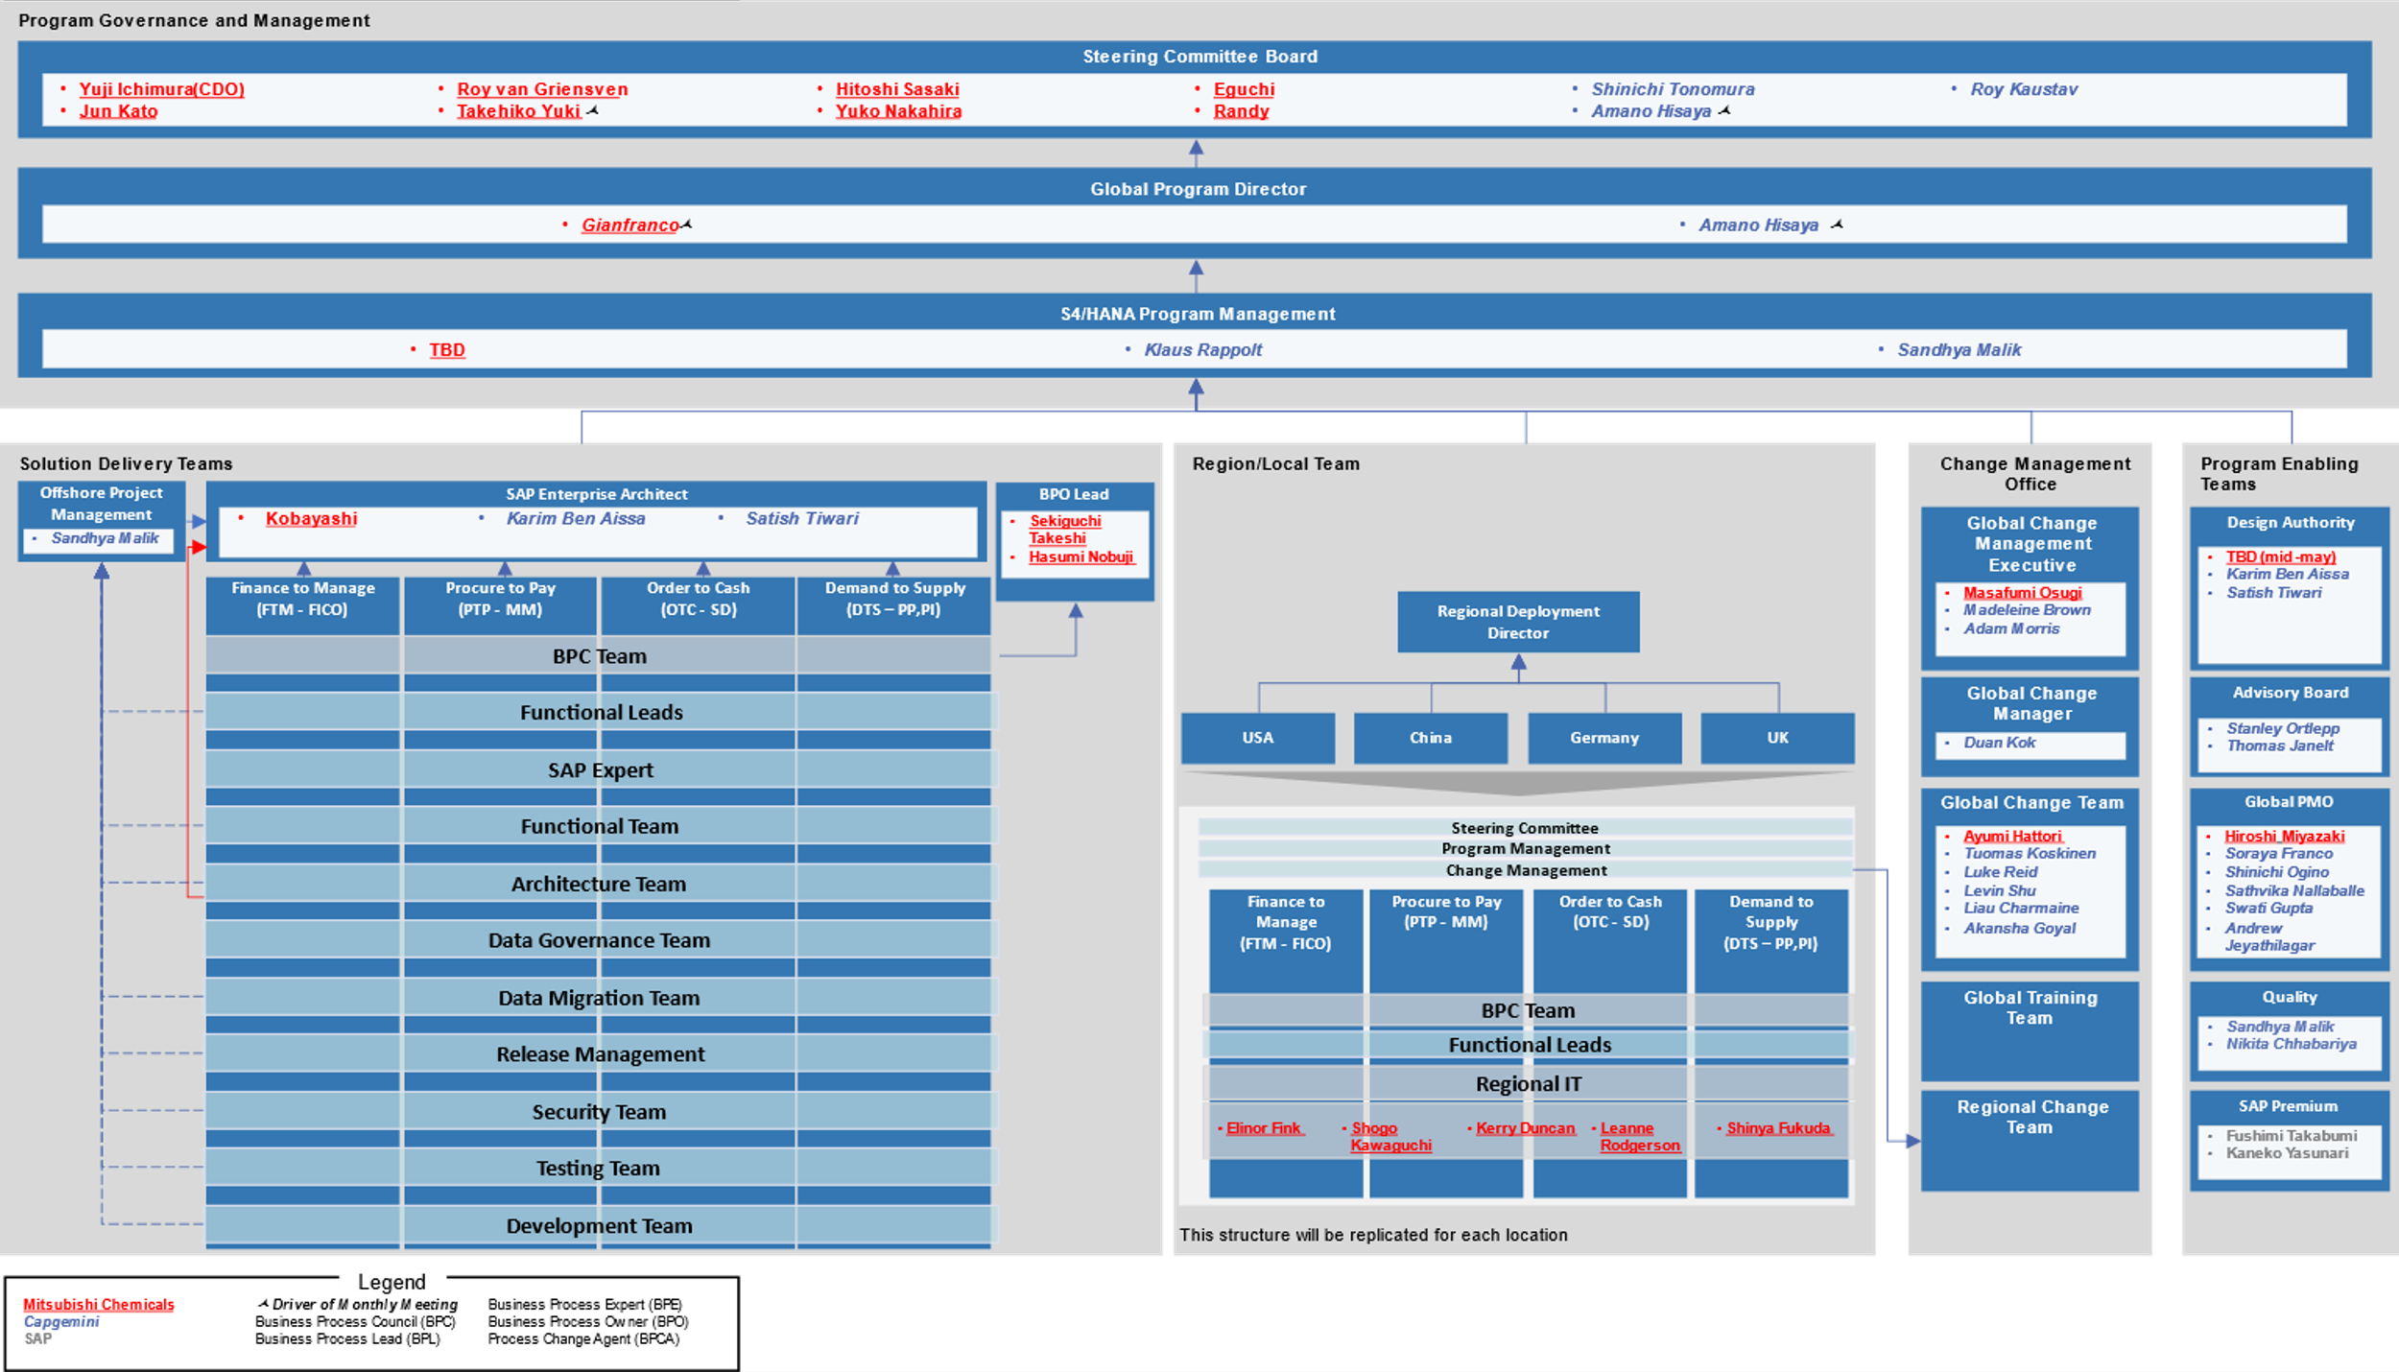
Organization Structure - Global

Slide 16
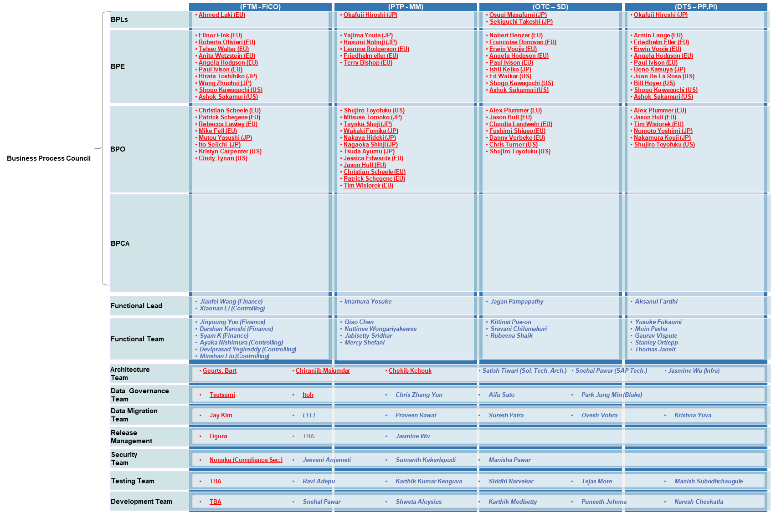
Organization Structure - Global

Slide 17
Mone-G Regional Organizational Structure - US
Regional Governance
and Management
Regional Program Director
Local Steering Committee Board
Program Management
Dalbir Sidhu
Mandeep Oberoi
Sumit Mathur
Solution Delivery Team
Change Management Office
Finance to Manage
(FTM - FICO)
Procure to Pay
(PTP - MM)
Order to Cash
(OTC - SD)
Demand to Supply
(DTS – PP,PI)
BPL
Regional Change Team
BPE
Melissa Ho
BPO
Key User
BPCA
Functional Lead
Kapil Biswas
Suhail Khan
Sreekanth Sankula
Randy Manning
SAP Expert
Functional Team
Data Migration Team
Testing Team
Development Team

Slide 18
Mone-G Regional Organizational Structure - China
Regional Governance
and Management
Regional Program Director
Local Steering Committee Board
Program Management
Cheng Long
Zhou, Liang
Chen, Sauwei
Solution Delivery Team
Change Management Office
Finance to Manage
(FTM - FICO)
Procure to Pay
(PTP - MM)
Order to Cash
(OTC - SD)
Demand to Supply
(DTS – PP,PI)
BPL
Regional Change Lead
Dylan Jiao
BPE
BPO
Key User
BPCA
Functional Lead
Wang, Rongrong
Jiang Nan
Fu Tijun
Liu Qin
Wu, Guangfeng
SAP Expert
Functional Team
Data Migration Team
Testing Team
Development Team
Notes:
Chen, Sauwei Pilot - China Mone-G Project China AE Cheng, Long Pilot - China Mone-G Project EM Zhou, Liang Pilot - China China ERP solution owner Wang, Rongrong Pilot - China SAP Controlling lead Wu, Guangfeng Pilot - China ERP Logistic lead Dylan Jiao Pilot - China OCM Lead Fu Tijun Pilot - China SAP - Materials Management Lead 1 (China) Jiang Nan Pilot - China SAP - Finance Lead 1 (China) Liu Qin Pilot - China SAP - Sales & Distribution Lead 1 (China) Huang, Xinyi Pilot - China PMO (China)

Slide 19
Mone-G Regional Organizational Structure - Germany
Regional Governance
and Management
Regional Program Director
Local Steering Committee Board
Program Management
Manfred Thebes
Lena Jansen
Juergen Veith
Solution Delivery Team
Change Management Office
Finance to Manage
(FTM - FICO)
Procure to Pay
(PTP - MM)
Order to Cash
(OTC - SD)
Demand to Supply
(DTS – PP,PI)
BPL
Regional Change Team
BPE
Hendrik Viereck
BPO
Key User
BPCA
Segler, Simone
Functional Lead
Damodar Naidu Paladugu
Rajput, Hemu
Sambhranta Mallick
SAP Expert
Bianca Liguori
Abdurahman Sahin
Functional Team
Data Migration Team
Armin Schmidt
Testing Team
Development Team

Slide 20
Mone-G Regional Organizational Structure - UK
Regional Governance
and Management
Regional Program Director
Local Steering Committee Board
Program Management
Abhishek Mehta
Sunil Mistry
Swati Dange
Solution Delivery Team
Change Management Office
Finance to Manage
(FTM - FICO)
Procure to Pay
(PTP - MM)
Order to Cash
(OTC - SD)
Demand to Supply
(DTS – PP,PI)
BPL
Regional Change Team
BPE
Sarah Wall
BPO
Key User
BPCA
Functional Lead
Moeen Rao
Simon Wichmann Matthiessen
Harish Manjunath
SAP Expert
Functional Team
Abdurahman Sahin
Data Migration Team
Testing Team
Development Team
Annupriya

Slide 21
Access related to Mone-G
DLs
SharePoint
Asana
DDF
AppStream
SAP system

Slide 22
Distribution lists
We currently have multiple active distribution lists. Detailed list is in the next slide
If any member is to be added to the DL’s, kindly drop a mail to DL JP MCG MoneG PMO Team.
In case of additional DL requirement, kindly add any of the above as admin.

Slide 23
Active Distribution lists - Global
DL Name | SPOC | Remark
DL JP MCG MoneG Global Data Team | Li Li | To address the Data migration & governance team
DL JP MCG MoneG Global Functional Team | Karim Ben Aissa | To address the functional team
DL JP MCG MoneG Global Team | Amano Hisaya | To address the whole MoneG Capgemini team
DL JP MCG MoneG Global Testing Team | Ravi Adepu | To address the testing team
DL JP MCG Mone Global Functional Lead Team | Karim Ben Aissa | To address the functional leads
DL JP MCG MoneG OCM Team | Duan Kok | To address the OCM team
DL JP MCG MoneG PMO Team | Soraya Franco | To address the PMO team To be kept in loop regarding all submissions and project management tasks
DL JP MCG MoneG Technical Global Team | Jasmine Wu | To address the technical team

Slide 24
Active Distribution lists - Local
DL Name | SPOC | Remark
DL JP MoneG China Roll Out Team | Cheng Long | For communication regarding roll outs in China
DL JP MoneG UK Roll Out Team | Sunil Mistry | For communication regarding roll outs in UK
DL JP MoneG US Roll Out Team | Mandeep Oberoi | For communication regarding roll outs in US
DL JP MoneG Germany Roll Out Team | Manfred Thebes | For communication regarding roll outs in Germany

Slide 25
Access (1/2)
Asana
Accept the invitation using the link in the mail ​
Go to “Home” and validate you have been assigned to a project
Complete the two - factor authentication.
Confirm your access to Global PMO.
Sharepoint – ConfExt_Mone_G
You will receive an email from no-reply@asana.com , check your spam folder ​
Global PMO will request your access.
You will receive an email from no-reply@sharepointonline.com , check your spam folder ​
Accept the invitation using the link in the mail ​
Create account and complete the two - factor authentication.
Confirm your access to Global PMO.
Global PMO will request your access.
Notify the onboarding to DL JP MCG MoneG PMO Team.
Notify the onboarding to DL JP MCG MoneG PMO Team.

Slide 26
Access (2/2)
CG Internal Teams / SharePoint Folder
AppStream
The Teams folder for the project is named ‘MCC – Mitsubishi Chemical Corporation’.
All documentation is to be updated in the channel -07_MoneG Delivery Folder
If any member is to be added to the Teams group, kindly drop a note to DL JP MCG MoneG PMO Team.
Notify the onboarding to DL JP MCG MoneG PMO Team.
Post approval from MCG, you will receive an email from no-reply@cloud-idf.com, check your spam folder ​
Follow the steps shown in the next slide
Global PMO will request your access.

Slide 27
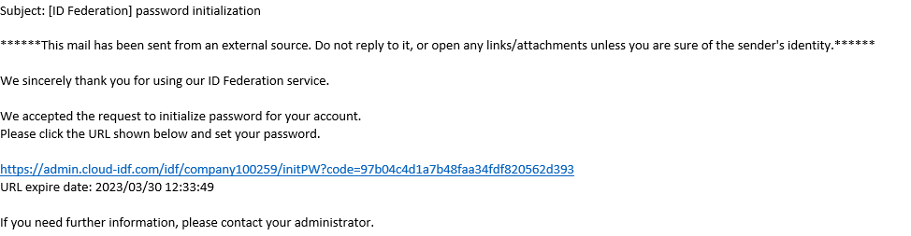
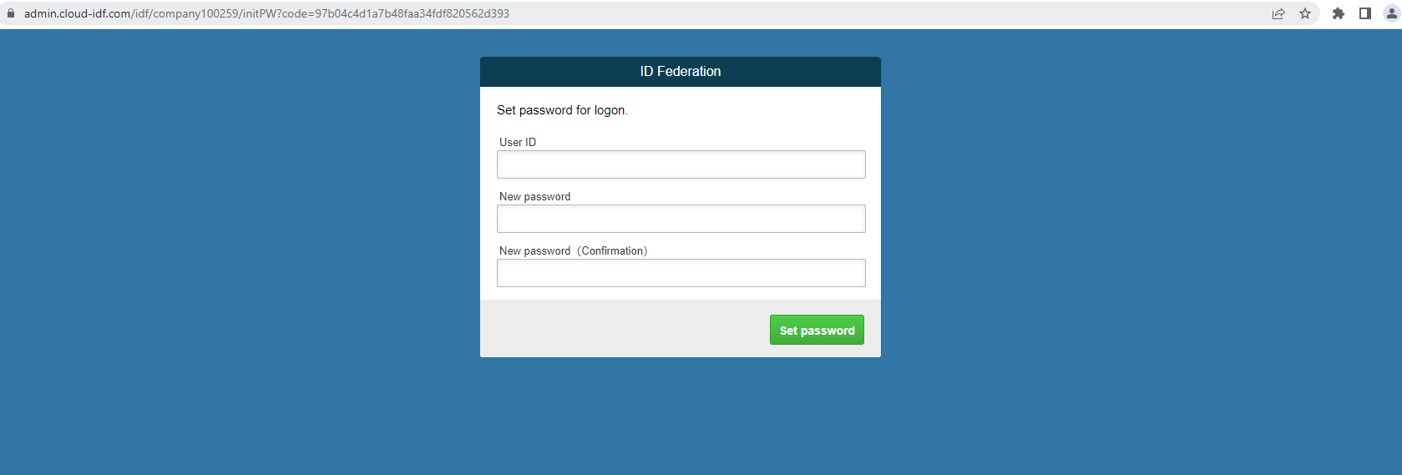
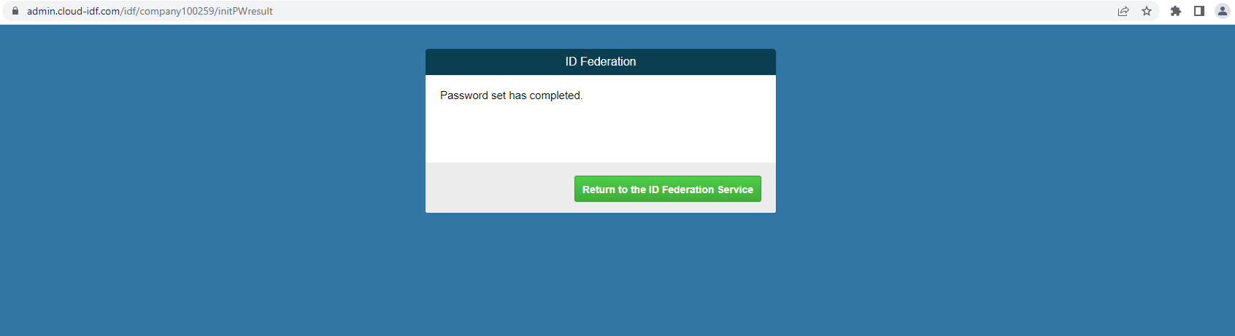
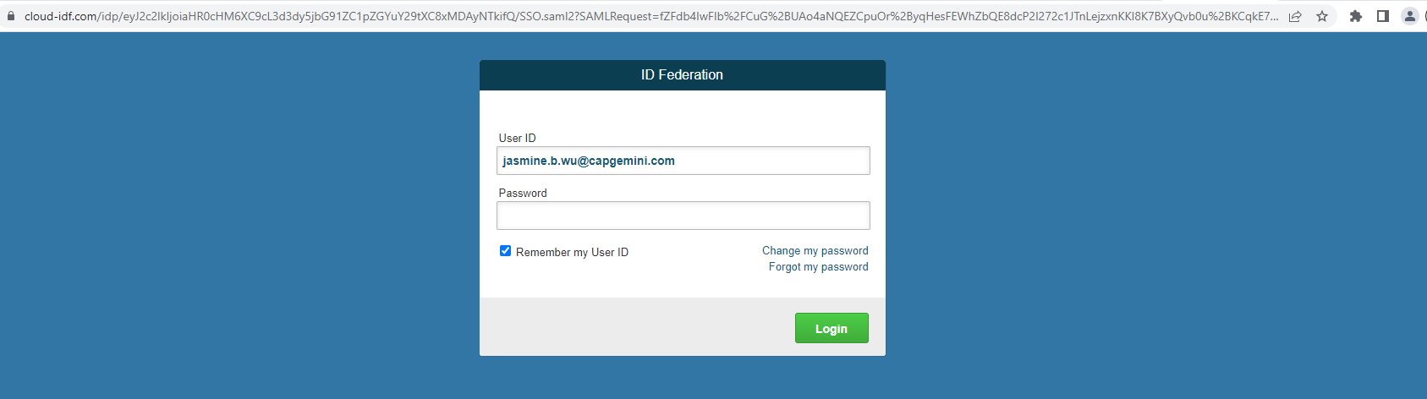
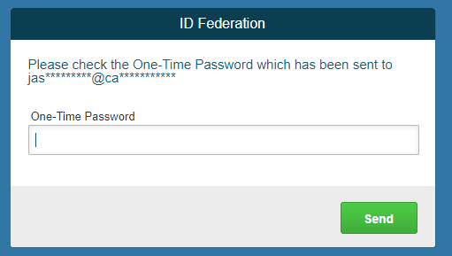
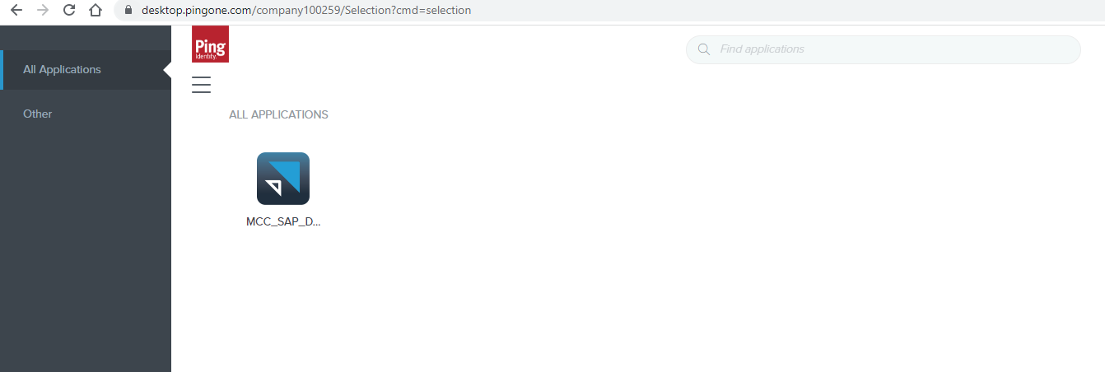
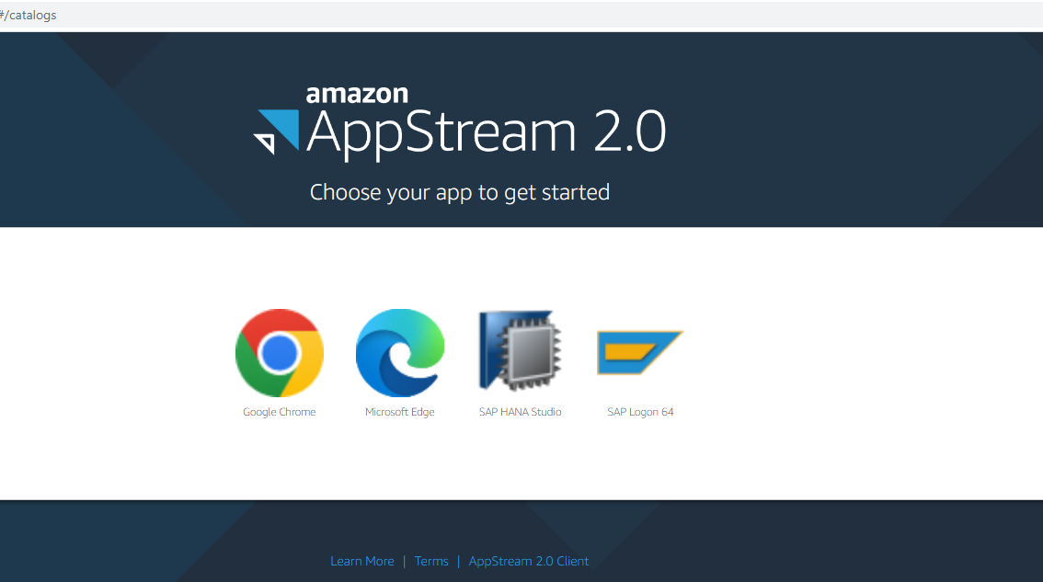
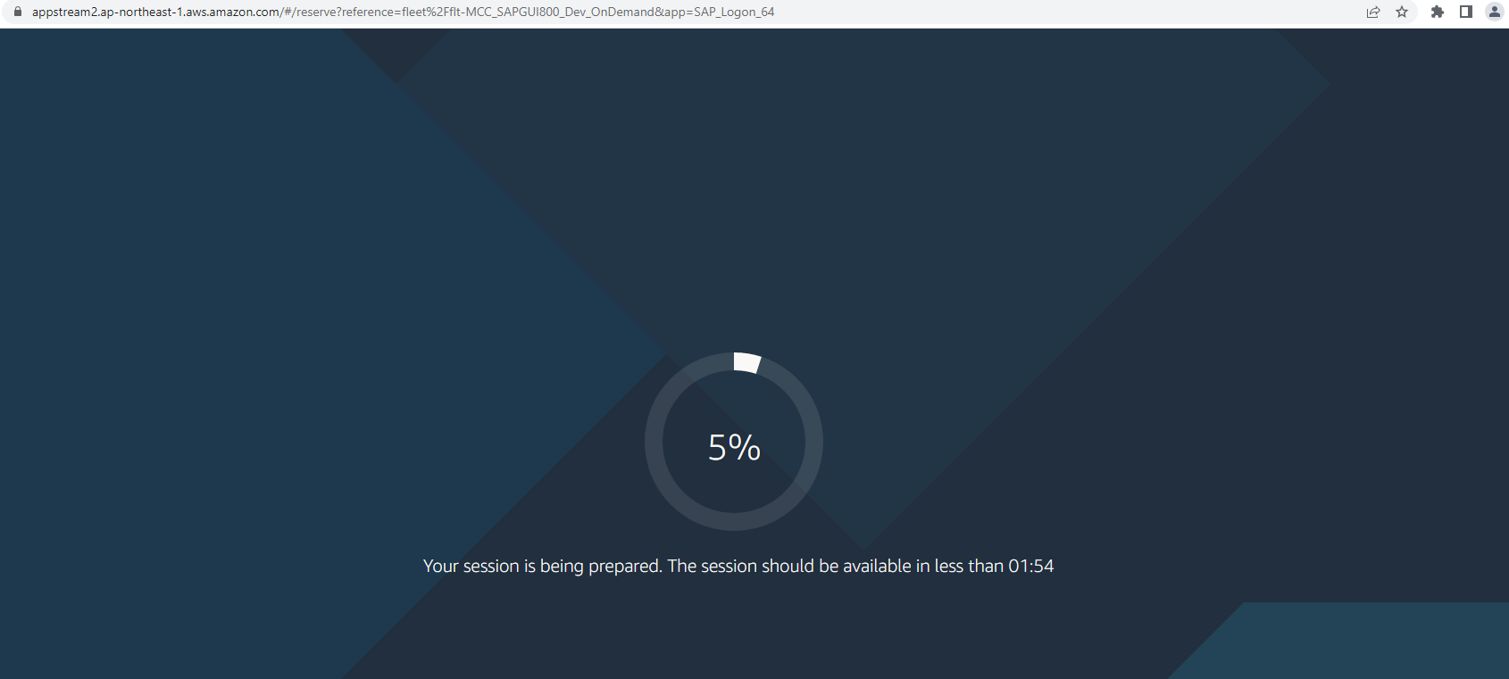
Initial set up for SAP APPSTREAM
1. Click on the URL in the welcome email from APPStream
Sub: [ID Federation] password initialization\
2. Set your password
3. Click on “Return to the ID Federation Service”
4. Login with your Capgemini email address and password just set
6. Click on icon MCC_SAP_Dev02
7. Click on app icon, like SAP GUI –SAP Logon 64
8. Give it a few seconds, and the apps will be ready to use
5. One-time password will be sent to your Capgemini mailbox, fill it in the window

Slide 28
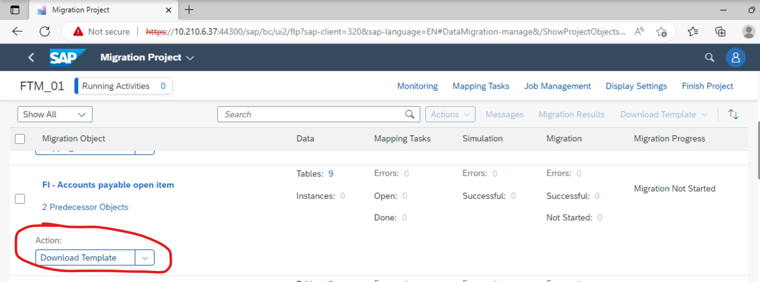
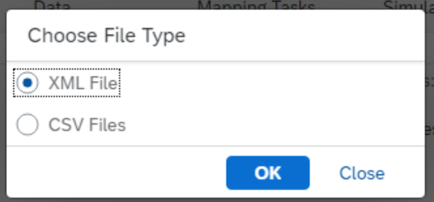
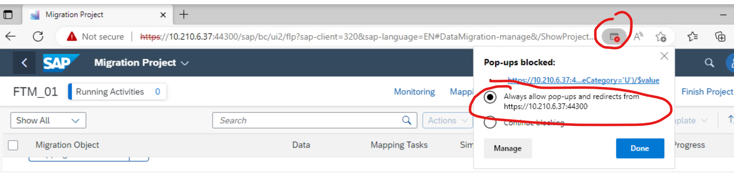
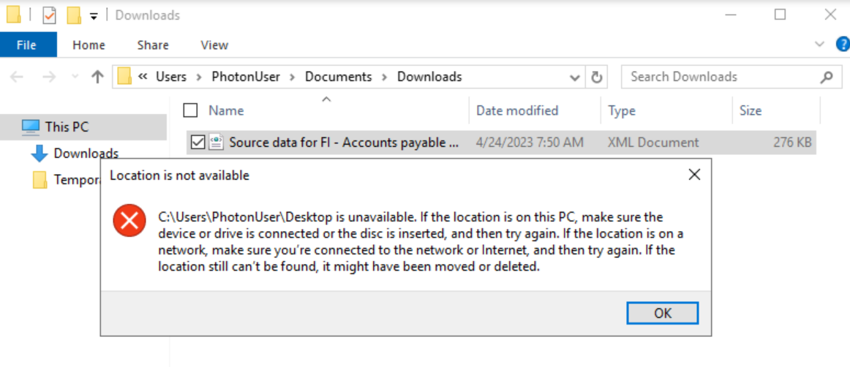
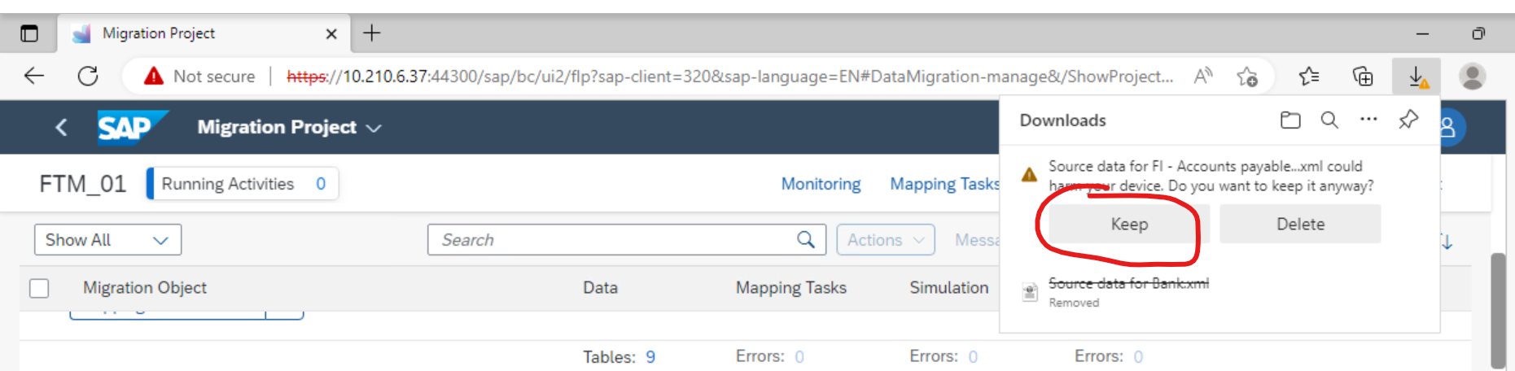
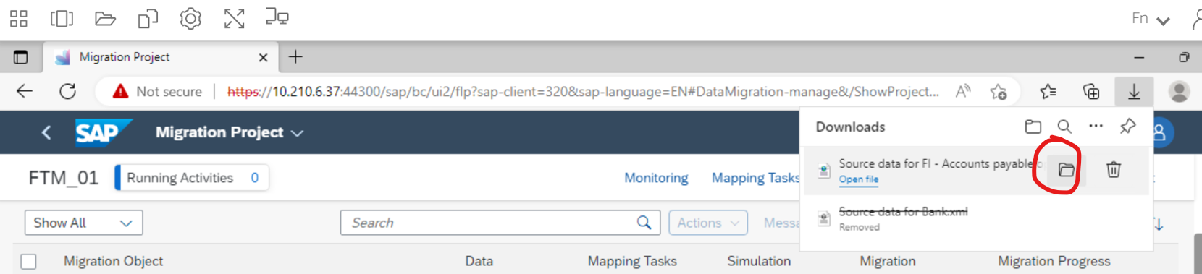
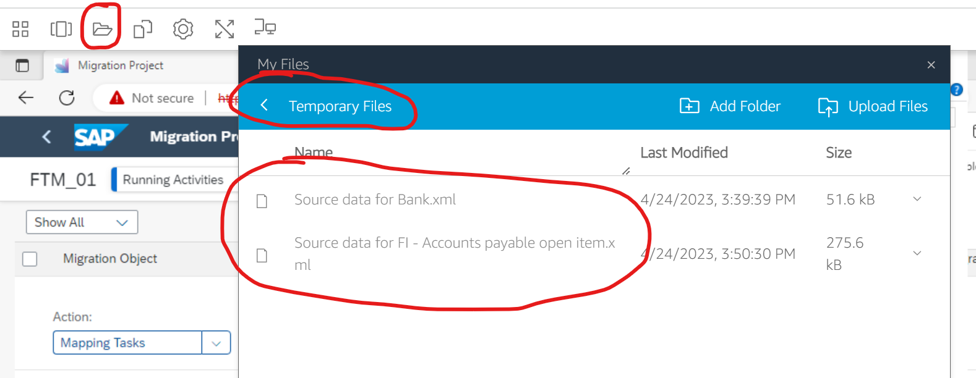
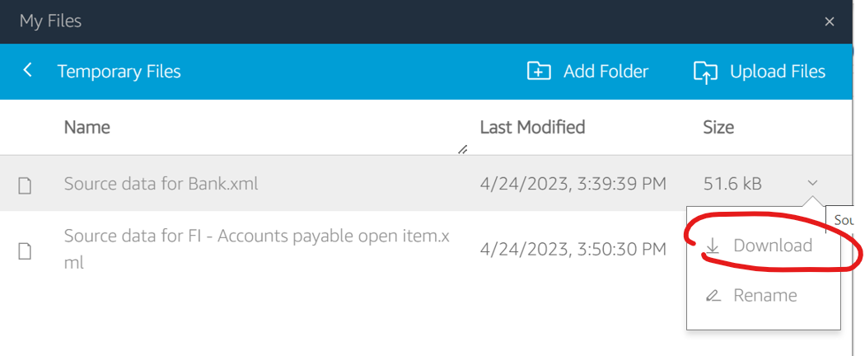
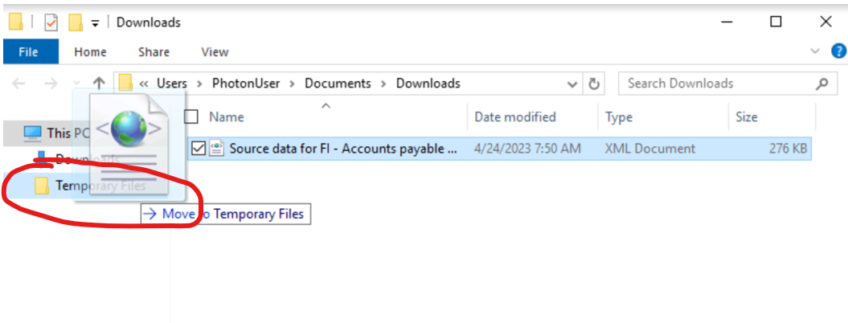
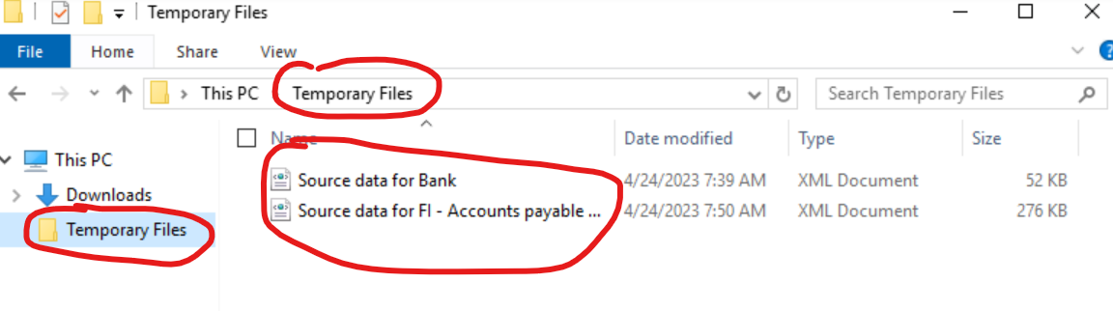
Steps to download file from AppStream into local drive
1. Click ‘download template’
2. Choose ‘XML file’, click ‘OK’
3. Click browser blocked button, choose allow option for downloading
4.Click download template again and click ‘Keep’ for Downloads.
5. Click show in folders.
6. Ignore the error, click ‘OK’’
7. Drag it into listed folder ‘Temporary Files’, this step is very important, you need to drag the files into this folder.
8. Click AppStream ‘folder’ button. You can see files sync up from This PC ‘Temporary Files’ folder.
9. Choose download, then you can have the file into your local from AppStream.

Slide 29
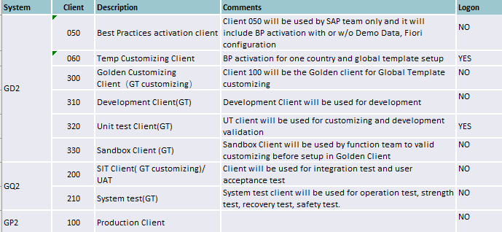
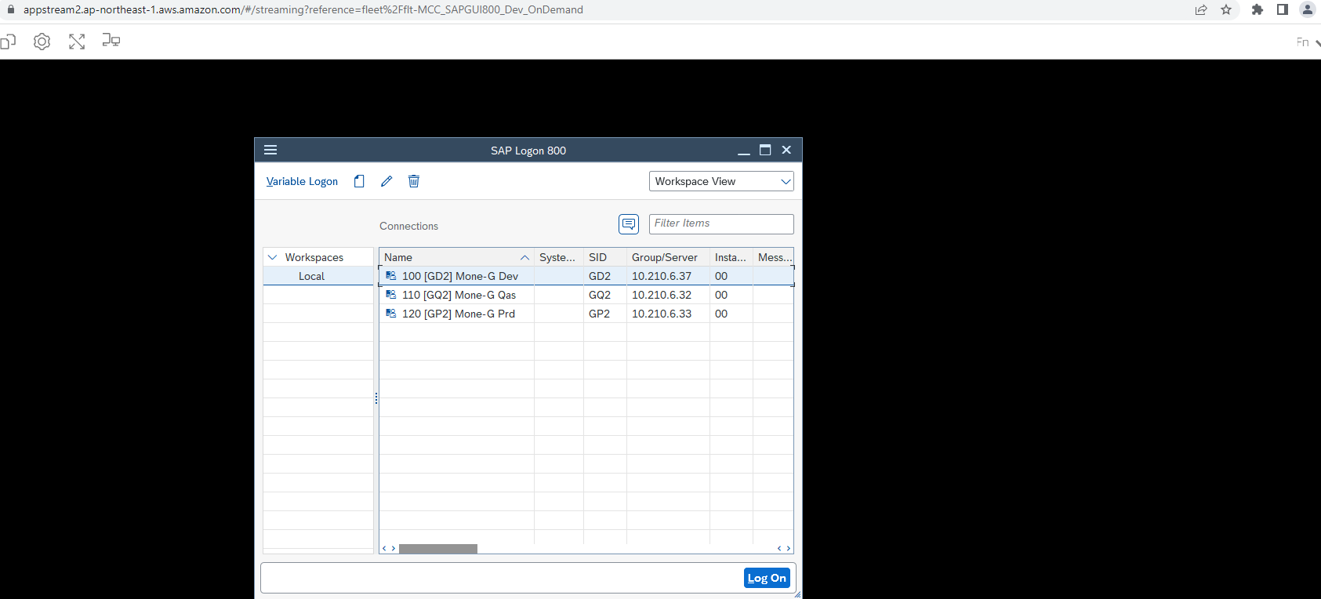
Client Details

Slide 30
Work Culture
Business Card Exchange
Bowing
Seat of honour
Command & Order

Slide 31
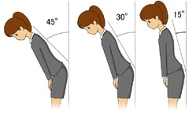
Business Card Exchange
Bowing
Always keep your business cards in clean condition.
Stand up and offer the card with the Japanese side facing upwards toward the recipient. Offering the card with both hands will demonstrate greater respect. Say “yoroshikuonegaishimasu”.
Receive the other person’s business card with both hands and bow. Say “Arigatougozaimasu.”
Hold the card by its edges, thank the person and read the card. You can inadvertently convey disrespect if you grab the card and simply shove it into your pocket. Absorbing what is on the card not only shows that you are interested, it also gives you a chance to learn something about the person and the company that could help you transition into a meaningful conversation.
If there are several Japanese, you will find that cards are presented according to rank, with the highest-ranking individual presenting his card last.
During a meeting, place the business cards on the table in front of you in the order people are seated.
When the meeting is over, put the business cards in a business card case or a portfolio.
Esyaku …..15 degrees. This is used when people come or leave the office.
Churei…… 30 degrees. This is used when people meet or see off their customers.
Keirei……..45 degrees. This is used during ceremonial occasions. This is used also when people would like to sincerely appreciate or apologize.

Slide 32
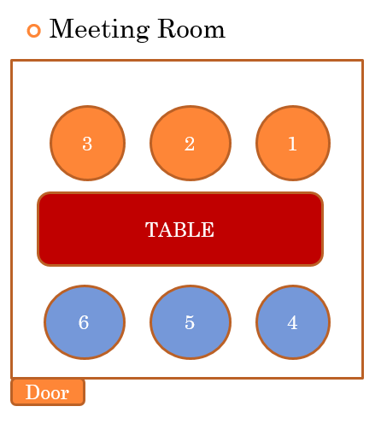
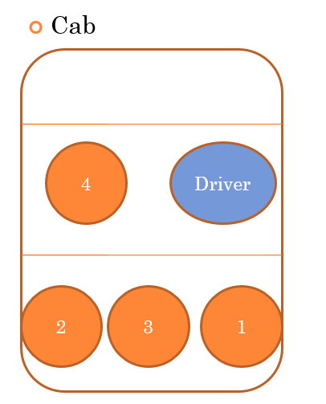
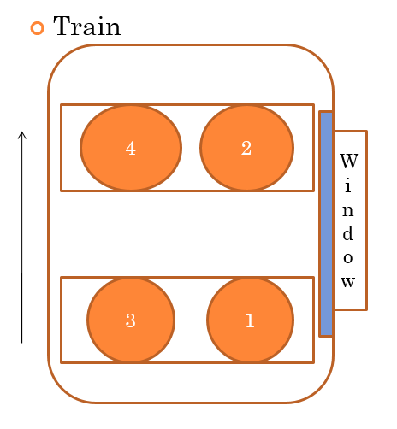
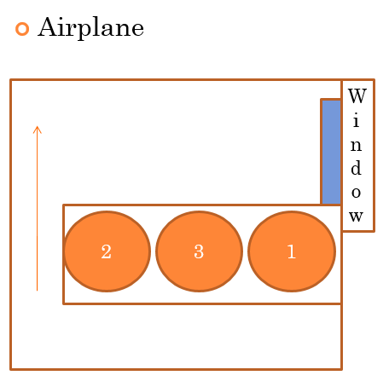
Seat Of Honour
Your clients will sit at No.1,2,3.
People from your company will sit at No.4,5,6.
Your client or a person with the highest rank will sit at No.1
A person with the lowest rank will sit at No.4.
The arrow represents the traveling direction.
The arrow represents the traveling direction.

Slide 33



Command And Order In Service Agreement
Capgemini
Customer
✓
Comprehensive work order
Team Lead / Project Lead
Team Lead / Project Lead
✓
×
Not direct work order
×
Team Members
Team Members
Meeting and Q&A is okay, but cannot make work order directly

Slide 34
Useful Links

Slide 35
Useful Links (1/3)
Topic | Link
SOW – Template Build & Pilot Phases | 20230629_Phase 1 Global Template Build Pilot Template Build and Phase 1Global Template Build Final.pdf
Testing Strategy | MCG Mone-G Test Strategy.pdf
Data Migration Strategy | MoneG_FS22_Data Migration Strategy.pdf
Client & Transport Strategy | MoneG_Client and Transport Strategy.pdf
Security Strategy | SAP Security Strategy v0.1.pdf
Development Strategy | Mone-G_Development Strategy.pdf
Organization Structure | MCG_Value_Stream_Organisation Structure.pptx
Configuration | Approach - MoneG_Global template_Configuration Guideline.pdf List - MoneG_Configuration Design List_1.0.xlsx
BPML | MoneG_BPML.xlsx
GAPs | List – MoneG Gap List.xlsx Presentations - Gaps
RICEFWs | List – MoneG RICEFW List.xlsx Presentations - RICEFWs
FDDs | 2_FS48_Functional Design Documents

Slide 36
Useful Links (2/3)
Topic | Link
Asana | https://app.asana.com/-/login Asana Tool_Walkthrough.pptx
AppStream logon | ID Federation (cloud-idf.com)
Japanese Culture | Do and Don't - Japan.doc Introduction to Japanese Business Culture_CGJ_V0.1.pptx MCG - Japan Culture-20221108_114831-Meeting Recording.mp4
Japanese Labor Laws | Japanese Workers Dispatch Law_20220325_CGL3.pptx 20211129_Compliance Checklist (Japan).docx
Non - Disclosure Agreement | 20220523_NDA_MCC PJ for global(EN).pdf
Project Governance Handbook | MCG_Project Governance.pptx
Pilot Proposal | 0623_Mone-G Mobilization, Assessment & Design Initial Proposal_vF.pdf
Teams Folders | 02. Assessment Phase (Oct - Mar) 03. Global Template Development Phase
Availability Tracker- GT | MCG_Availability Tracker.xlsx
Facebook | Facebook - MCG.pptx
Talent Page (India) | https://talent.capgemini.com/in
Clarity - Japan | https://clarity.fs.capgemini.com/niku/nu#action:homeActionId
Timecard Application - India | https://timecard.in.capgemini.com

Slide 37
Useful Links (3/3)
Topic | Link
Trainings | Chemical Industry - https://capgemini.sumtotal.host/core/pillarRedirect?relyingParty=LM&url=app%2Fmanagement%2FLMS_ActDetails.aspx%3FActivityId%3D937324%26UserMode%3D0 Data: Working Securely Everywhere - 3/5: Cybersecurity Essentials Understanding Privacy Data Classification And Security - 4/5: Cybersecurity Essentials Presentation: MoneG - Capability and Knowledge Share.pptx
iCaptivate | MCG_iCaptivate Methodology.pptx https://km3.capgemini.com/book/1082915 https://capgemini.sharepoint.com/sites/NAR_Site2/SAPMethodology/CAPtivate/default.aspx https://capgemini.sumtotal.host/core/pillarRedirect?relyingParty=LM&url=app%2Fmanagement%2FLMS_ActDetails.aspx%3FActivityId%3D787777%26UserMode%3D0
E- GREAT | https://e-great.capgemini.com/estimates https://capgemini.sharepoint.com/sites/e_GREAT

Slide 38
Compliance
Timesheets
Availability
Non-Disclosure

Slide 39
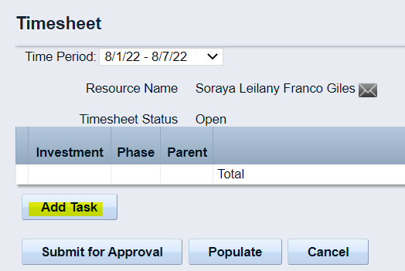
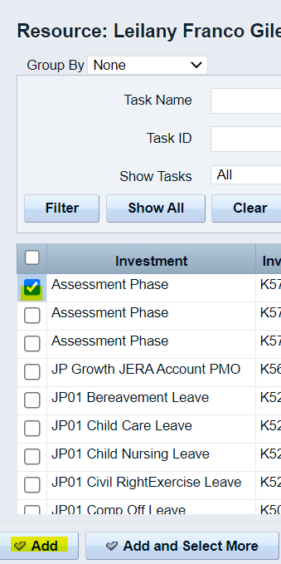
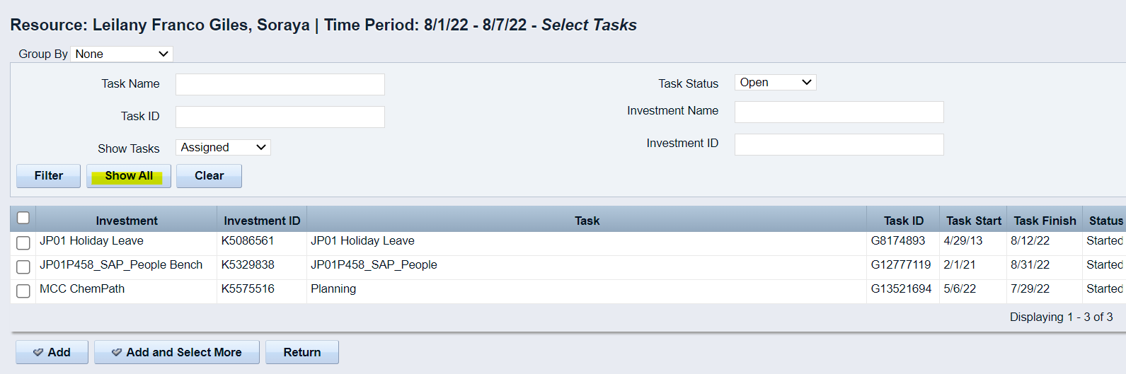
Time Sheets – Japan Resources
Enter Clarity (link)
Click on “Add Task”
Click on “Show All”
Search for the investment “Assessment Phase”, select and click on Add

Slide 40
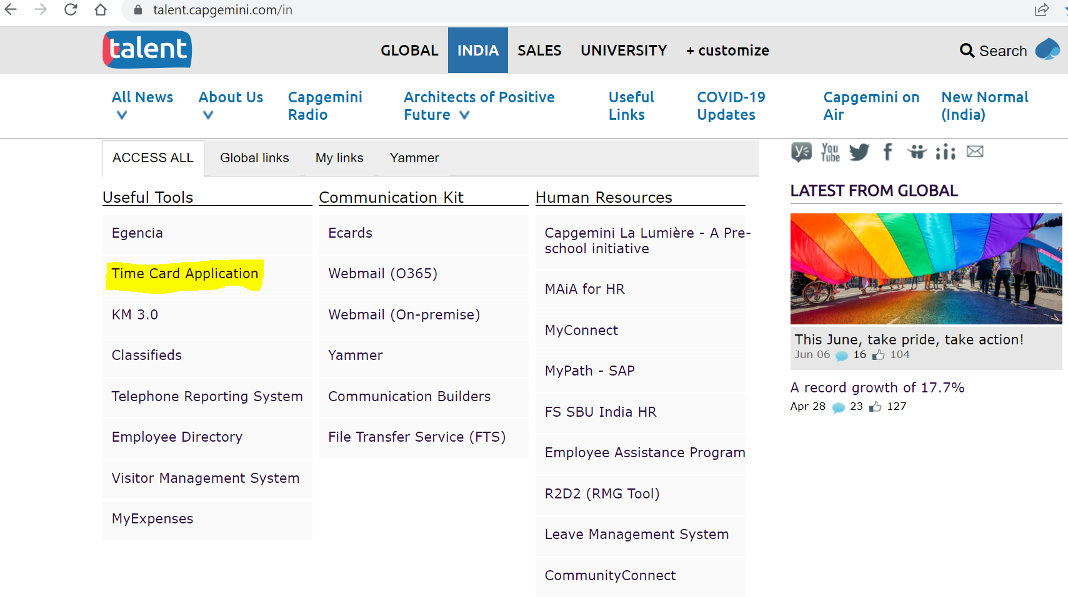
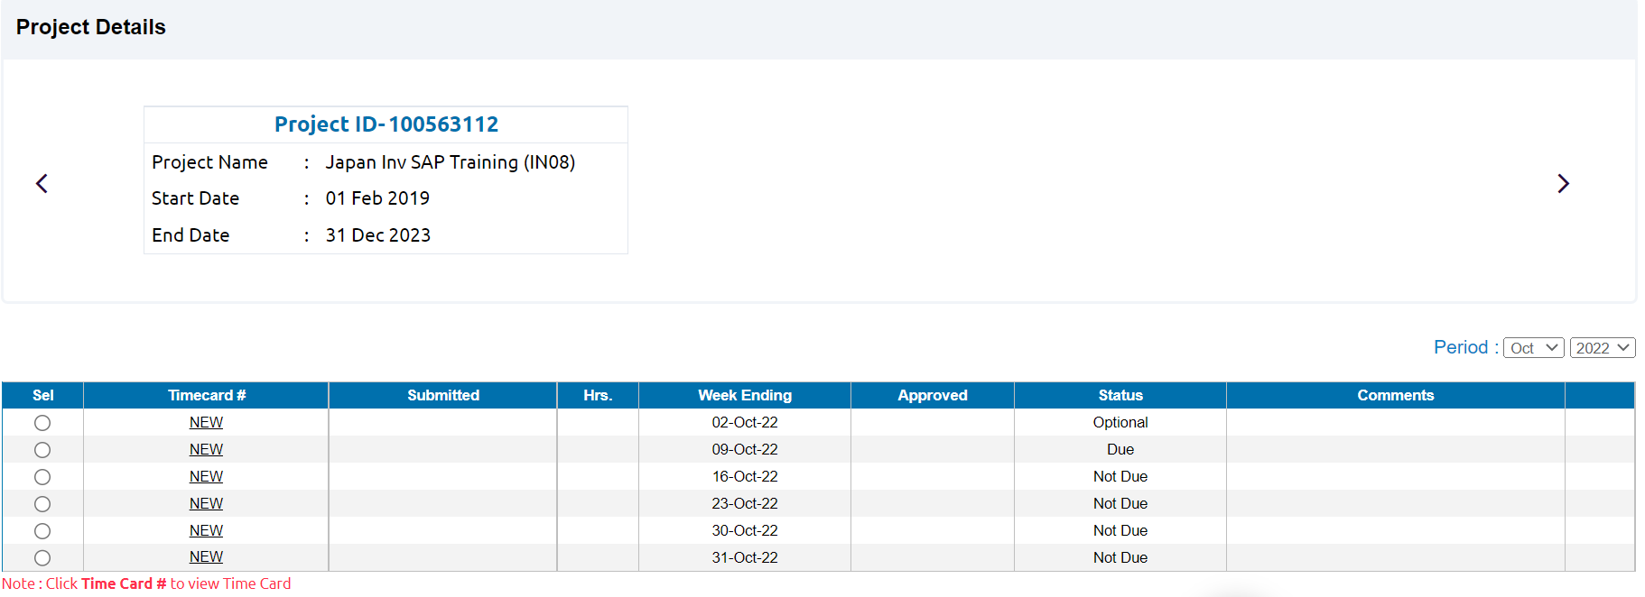
Time Sheets – India Resources
To update your Time Card.
1. Access https://talent.capgemini.com/in
2. Under Access All > Useful Tools > Timecard Application.
3. Click on Time-Card Application >Time Summary>Project Details> New>Fill details>Submit
Note that all learning & development activities are to be booked over and above the 9hrs on project.
You are expected to fill your timecards every Friday and get it approved at the latest by last Monday of each month.

Slide 41
Timesheets – Others
Fill in the excel attached
Submit to the PMO team every 25th day

Slide 42
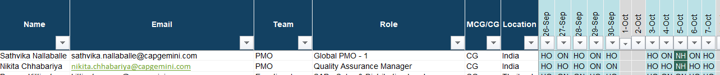
Availability Tracker
It is a tracker that shows the availability & location of all MCG team.
You are expected to fill in the availability before 5th of each month.
Refer the picture below.
Please note the below
AL | Annual Leave
NH | National Holiday
HO | Home
ON | Onsite/Office
Leave Process
Drop a mail to your lead with PMO team in cc.
Plan your KT to your backup team member.
As agreed with your lead, apply in the system.
Get leave approved by your supervisor.
Once done, update the availability tracker.

Slide 43
Non-Disclosure: Key Points
Confidential Information
All documents and materials with respect to the project in any form (e.g., verbal, print, oral, electronic etc.) are referred to as confidential information.
All samples (product or document) are considered confidential information.
Confidentiality Obligations
The above are to be disclosed in a tangible form and marked 'confidential'.
The above are to be safe guarded and not used for any other external purpose.
The above can be disclosed only to own or affiliated companies which have the same legal obligations.
In case of mandatory disclosure, notice is to be provided and compliance is to be mutually waived off.
Exceptions to Confidential Information
Information already known and available in public domain.
Any material created without relevance to the project.
Termination
Five years after expiration of the agreement.
Mutually waived off with 30 days of notice.
Return / Destruction
All confidential information is property of the author company and can be returned or destructed as per them.
The disclosure of any Confidential Information cannot constitute any license, obligate any further agreement.
It is mutually agreed that there would be no exclusivity and no warranty.
Kindly refer to the agreement for further details. (Link in slide 36)

